Slide 1
CS 2160 Chapter 1
Abstractions and Technology

Slide 2
The Computer Revolution
Began in the 1940s
Now accounts for 10% of GNP
Progress in computer technology
Underpinned by Moore’s Law
Makes novel applications feasible
Computers in automobiles
Cell phones
Human genome project
World Wide Web
Search Engines
Density doubles every 18-24 months
3

Slide 3
Classes of Computers
Single User
Desktop computers
General purpose, variety of software
Subject to cost/performance tradeoff
Server computers
Network based
High capacity, performance, reliability
Range from small servers to building sized
Embedded computers
Hidden as components of systems
Stringent power/performance/cost constraints
Update
Personal mobile devices
Warehouse computing systems
Multiple Users
Device-Dependent
5

Slide 4
The Processor Market
Exponential Rise
"^{c:}'
O+---- -
2007 2008 2009 2010 2011 2012
7

Slide 5
What You Will Learn
How programs are translated into the machine language
And how the hardware executes them
The hardware/software interface
What determines program performance
And how it can be improved
How hardware designers improve performance
What is parallel processing
8

Slide 6
Understanding Performance
Algorithm
Determines number of operations executed
Not so much covered in this book
Programming language, compiler, architecture
Determine number of machine instructions executed per operation
Processor and memory system
Determine how fast instructions are executed
I/O system (including OS)
Determines how fast I/O operations are executed
9

Slide 7
8 Great Architecture Ideas
Design for Moore’s Law
Use abstractions to simplify design
Make the common case fast
Parallelism
Pipelining
Prediction
Memory Hierarchy
Reliability via Redundancy
11

Slide 8
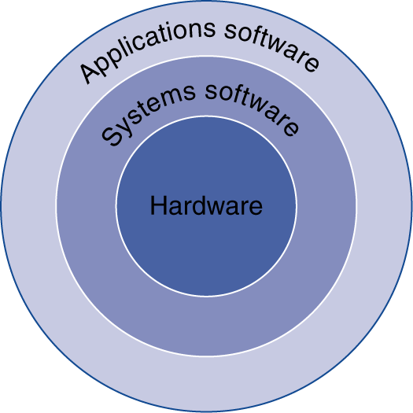
Below Your Program
Application software
Written in high-level language
System software
Compiler: translates HLL code to machine code
Operating System: service code
Handling input/output
Managing memory and storage
Scheduling tasks & sharing resources
Hardware
Processor, memory, I/O controllers
§1.2 Below Your Program
13

Slide 9
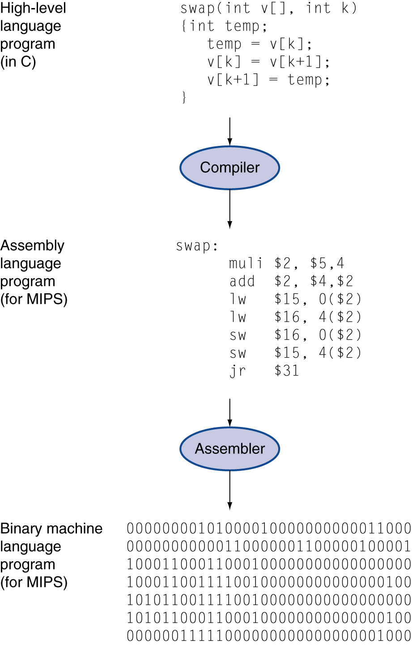
Levels of Program Code
High-level language
Level of abstraction closer to problem domain
Provides for productivity and portability
Assembly language
Textual representation of instructions
Hardware representation
Binary digits (bits)
Encoded instructions and data
Translates high-level code into low-level instructions
Translates low-level instructions into machine(like) code
15

Slide 10
That was Then, This is Now
Previous slide is the compile-assemble-link process that is used in languages like C or C++
Java and C# use a different process
Source code compiled to byte code
Byte code is machine independent
Java Byte Code for Java, Microsoft Intermediate Language (MSIL) for C#
Executed by a machine-specific run-time
Java Virtual Machine for Java, .Net Framework for Microsoft

Slide 11
Writing Assembly Code
MIPS Assembler and Runtime Simulator
Download from Blackboard
It’s a .jar file, so double-clicking on the file will run it

Slide 12
The strcpy Example
.data #data declarations follow
Source:
.asciiz "A string to copy. " # Source string
Dest:
.asciiz “ " #Blank space into which to copy the source string
.text # assembly code follows
la $a1, Source
la $a0, Dest
jal strcpy
li $v0, 10 #loads op code into $v0 to exit program
syscall #reads $v0 and exits program
strcpy:
addi $sp, $sp, -4 # adjust stack for 1 item
sw $s0, 0($sp) # save $s0
add $s0, $zero, $zero # i = 0
L1: add $t1, $s0, $a1 # addr of y[i] in $t1
lbu $t2, 0($t1) # $t2 = y[i]
add $t3, $s0, $a0 # addr of x[i] in $t3
sb $t2, 0($t3) # x[i] = y[i]
beq $t2, $zero, L2 # exit loop if y[i] == 0
addi $s0, $s0, 1 # i = i + 1
j L1 # next iteration of loop
L2: lw $s0, 0($sp) # restore saved $s0
addi $sp, $sp, 4 # pop 1 item from stack
jr $ra # and return

Slide 13
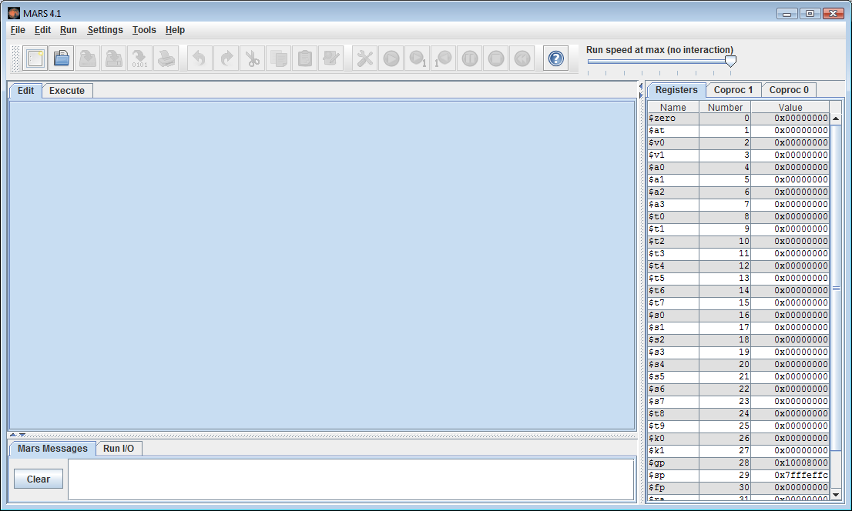
Run MARS
Select File | New
Paste in strcpy code

Slide 14
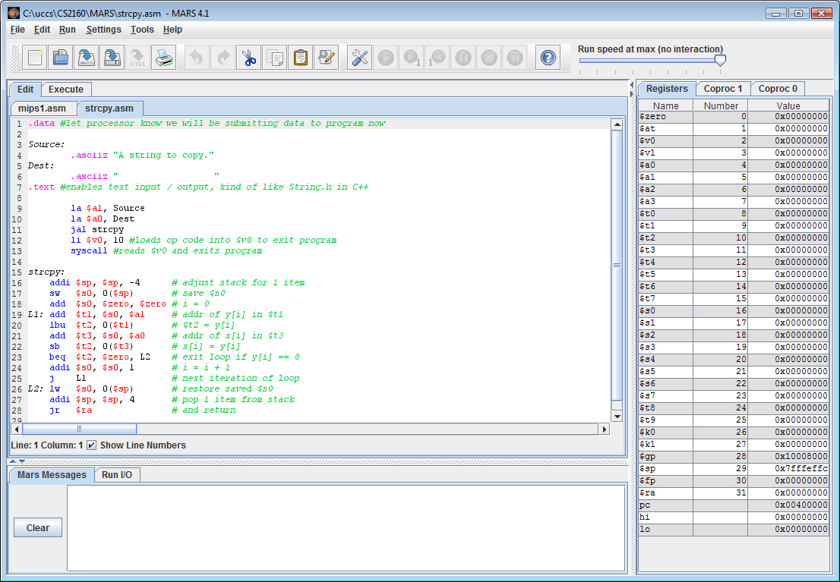
Save and Assemble
Save file
Select
Run | Assemble

Slide 15
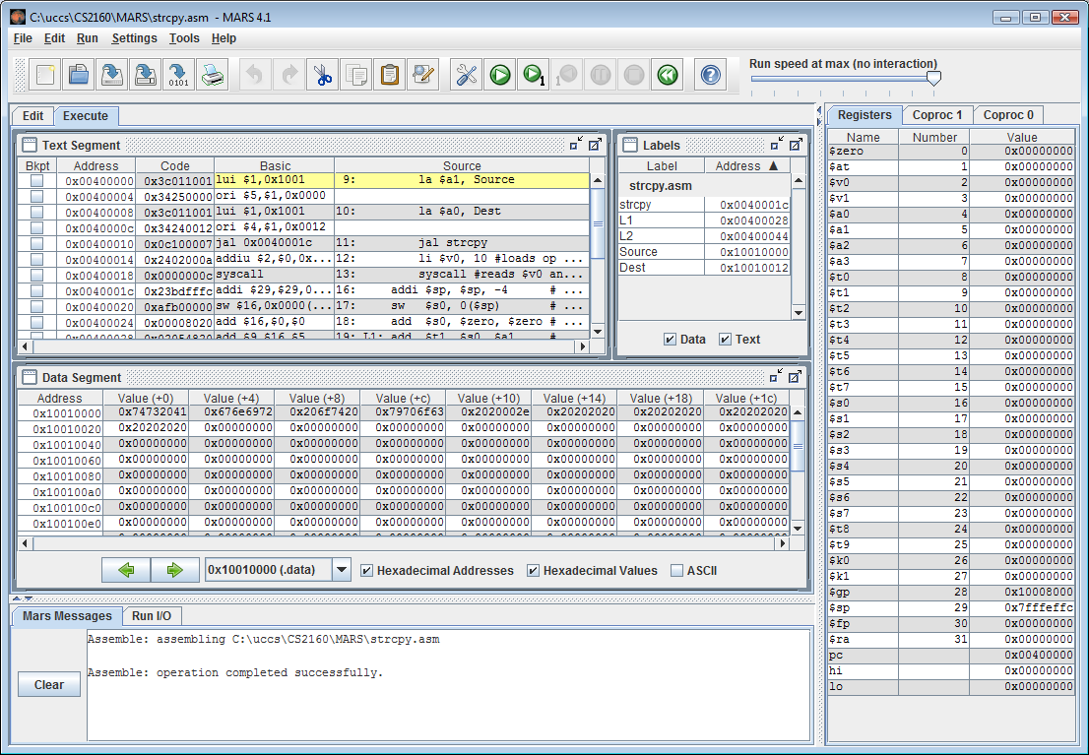
Step Through Program with f7

Slide 16
For Next Time
Not graded, but…
Download MARS from Blackboard
Try pasting in the strcpy code and running it, step-by-step
See if you understand what’s happening in the registers and in memory

Slide 17
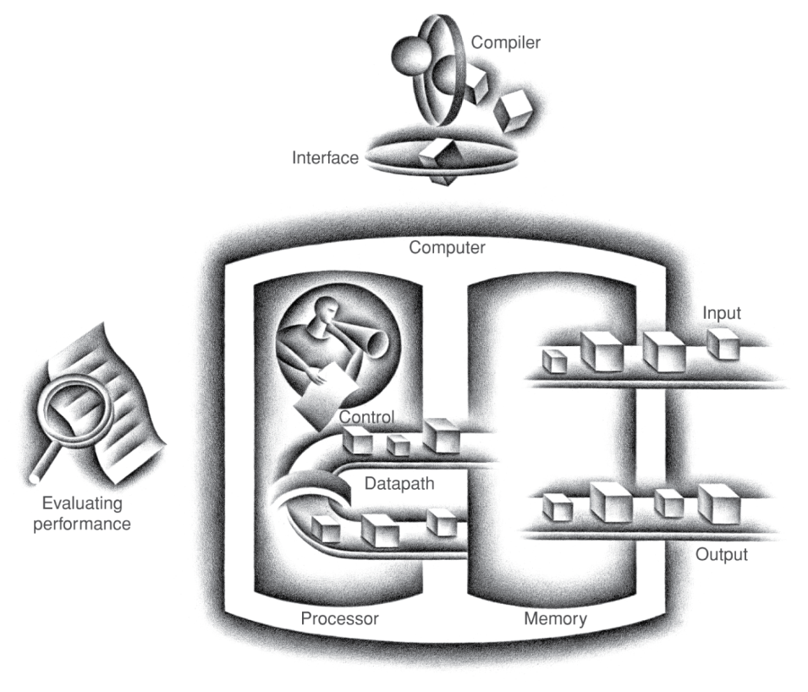
Components of a Computer
Same components for all kinds of computer
Desktop, server, embedded
Input/output includes
User-interface devices
Display, keyboard, mouse
Storage devices
Hard disk, CD/DVD, flash
Network adapters
For communicating with other computers
§1.3 Under the Covers
The BIG Picture
17

Slide 18
Email: put CS 2160 in the subject line, or at least mention it in the e-mail.
May not be able to give HW help within 24 hrs of the due time.
Homework

Slide 19
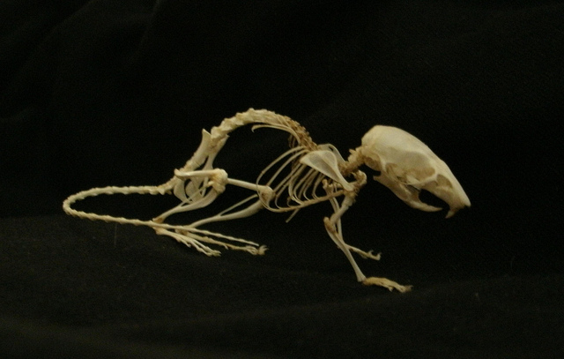
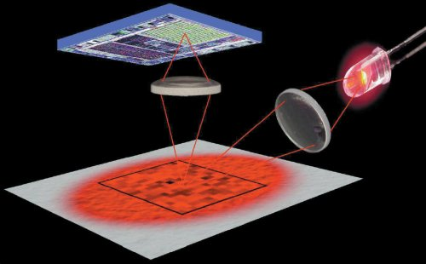

Anatomy of a Mouse
Optical mouse
LED illuminates desktop
Small low-res camera
Basic image processor
Looks for x, y movement
Buttons & wheel
Supersedes roller-ball mechanical mouse

Slide 20
Anatomy of a Mouse
Optical mouse
LED illuminates desktop
Small low-res camera
Basic image processor
Looks for x, y movement
Buttons & wheel
Supersedes roller-ball mechanical mouse

Slide 21
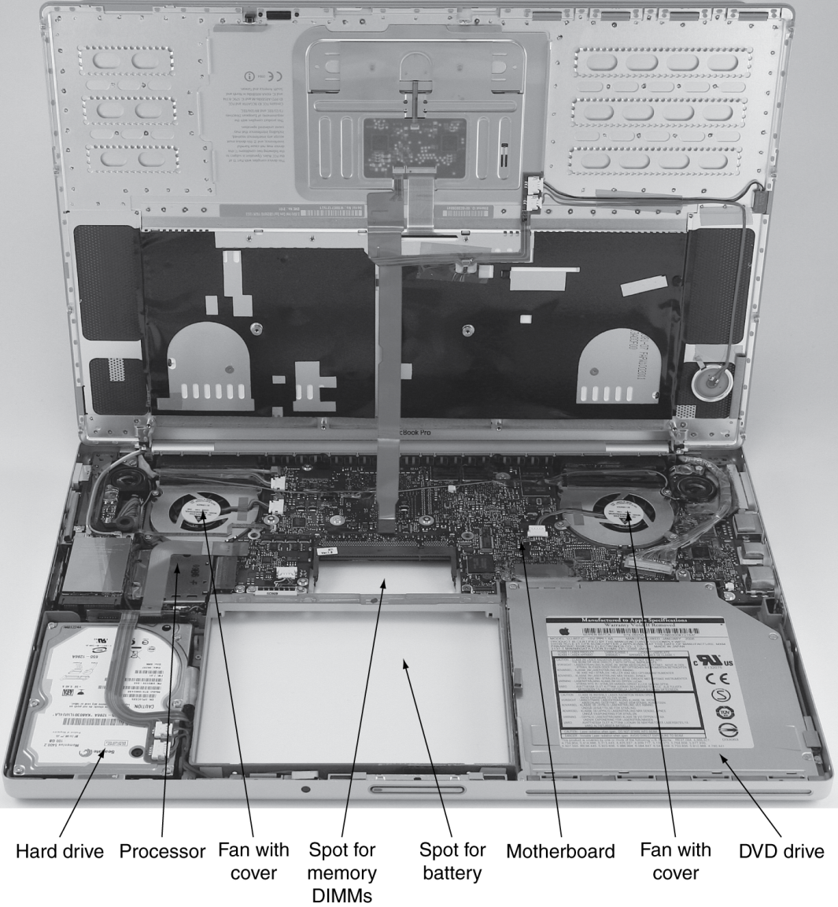
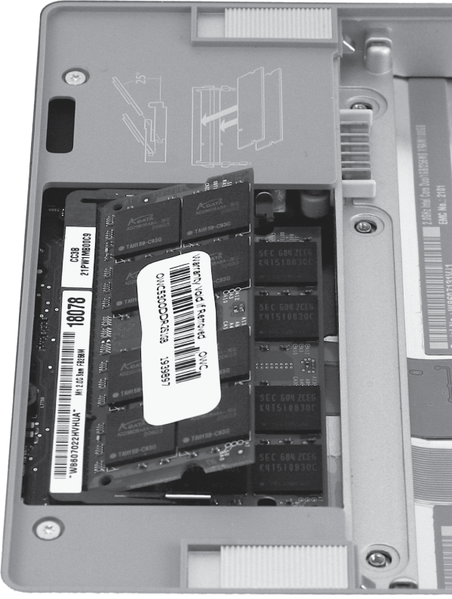
Inside a Laptop
Major features are chips and connectors: things that do things and move things around

Slide 22
Through the Looking Glass
This is old technology. Currently Liquid Crystal Displays are used with Active Matrix technology.
In color graphics, each picture element (pixel) on the screen represents at least 24 bits of data
18

Slide 23
Touch Screens
Replacement for keyboard and mouse
Great for mobile devices
Capacitive sensing
Presence of a finger or conductive stylus can be sensed by a change in the electrostatic field on the screen
Multiple-touch technology allows interpretation of multiple hot spots, usually used to expand and contract display sizes.
19

Slide 24
Inside an iPad
Camera, headphone
Jack, microphone
Screen
Display lock/
Accelerometer
“Motherboard”
Batteries
Speaker
Touch screen controller
Cable
Wifi/FM/
Bluetooth
Metal back
Bezel
20

Slide 25
Inside the Processor (CPU)
Datapath: performs operations on data (arithmetic)
Control: sequences datapath, memory, ...
Cache memory
Small fast SRAM memory for immediate access to data
21

Slide 26
Inside the Processor
2-core ARM 5
10 x 12 mm
Includes
graphics processor
Cache memory
Wireless interface
Audio interface
Memory interface
I/O interface
21

Slide 27
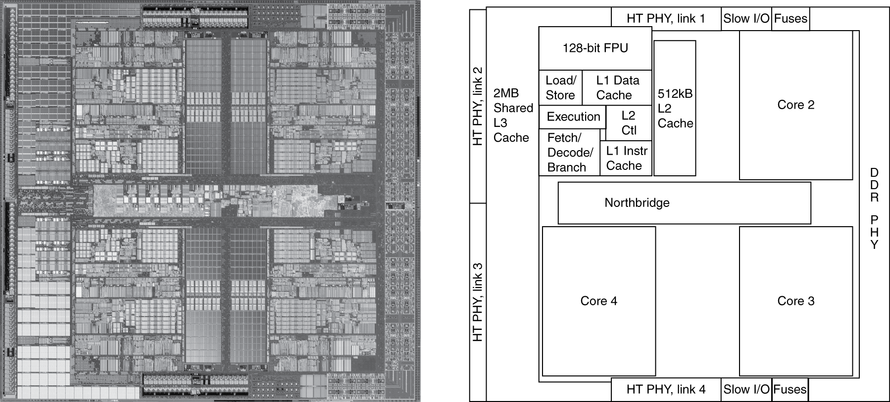
Inside the Processor
AMD Barcelona: 4 processor cores

Slide 28
Memory Hierarchy
L1 cache
L2 cache
L3 Cache
Main Memory
Local Disk (magnetic or solid-state)
Other storage
Optical disks
Network or remote storage
SRAM
Volatile memory
DRAM
Non-volatile memory
23

Slide 29
More on Cache
Multiple levels
Typically L1, L2 on chip, per core
L3 on or off chip, shared
Main memory and Disk system are extensions
On-chip memory typically Static Random Access Memory (SRAM)
Uses more power, produces more heat, is faster
Main memory Dynamic RAM
Requires refresh cycles
Slower
Way cheaper

Slide 30
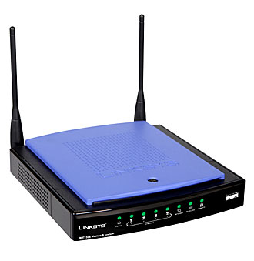
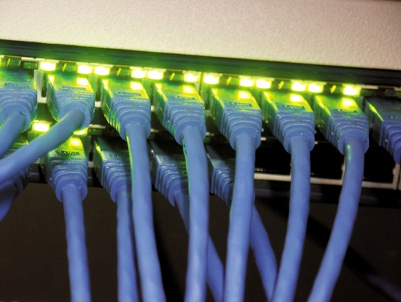
Networks
Communication and resource sharing
Local area network (LAN): Ethernet
Within a building
Wide area network (WAN: the Internet
Wireless network: WiFi, Bluetooth
Long Range
(100 m)
Short Range
(1 m)

Slide 31
Network Balance Sheet
Advantages
Disadvantages
Resource sharing
Remote access
Convenience
Distributed nature
Security
Speed
Node failure

Slide 32
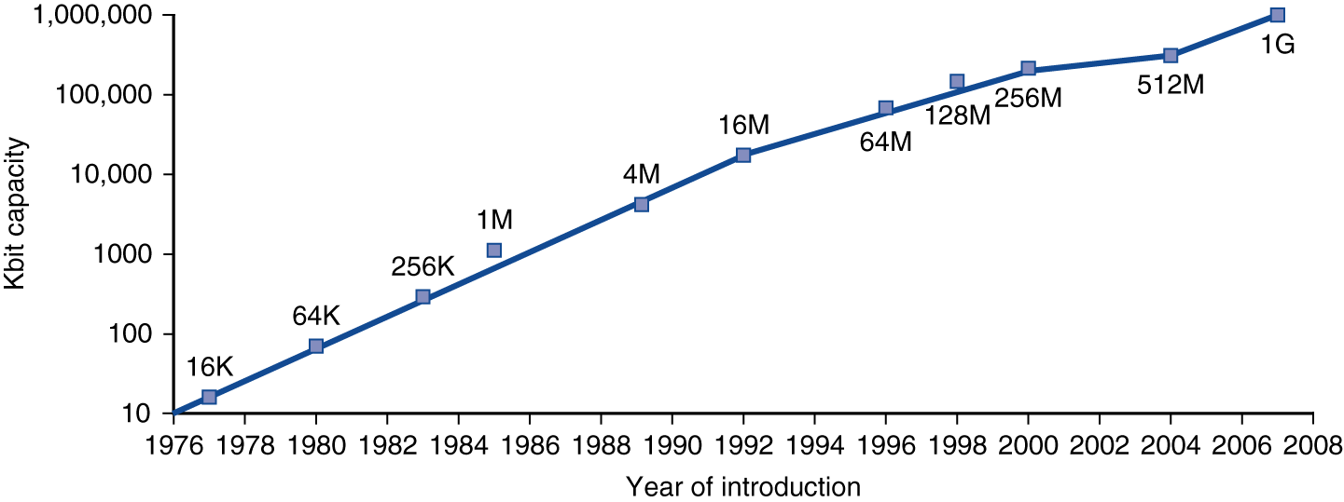
Technology Trends
Electronics technology continues to evolve
Increased capacity and performance
Reduced cost
Moore’s Law
DRAM capacity
Year | Technology | Relative performance/cost
1951 | Vacuum tube | 1
1965 | Transistor | 35
1975 | Integrated circuit (IC) | 900
1995 | Very large scale IC (VLSI) | 2,400,000
2005 | Ultra large scale IC | 6,200,000,000

Slide 33
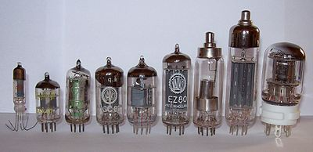
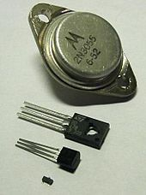
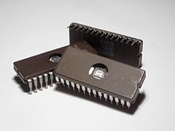
What’s a Transistor?
Collector
Base
Replaced vacuum tubes
Emitter
It’s a switch that uses the base to control the current flowing between the collector and emitter.
It comes in two varieties: PNP (shown) and NPN based on the positive or negative doping of the silicon layers
Old style
(Discreet components)
More recently:

Slide 34
Chip Fabrication Process
26

Slide 35
Wafer with Dies
Wasted space, but not worth masking
Intel Core i7
12” wafer
100% yield = 280
32nm process
20.7 x 10.5mm die
27

Slide 36
Binary Refresher
2¹⁰ is roughly 1000 (1024, actually)
So 2¹⁰ is about 10³
Thus:
Binary | Decimal | Decimal Name
2¹⁰ | 10³ | Kilo-
2²⁰ | 10⁶ | Mega-
2³⁰ | 10⁹ | Giga-
2⁴⁰ | 10¹² | Tera-
2⁵⁰ | 10¹⁵ | Peta-

Slide 37
More About Binary
Can be used to represent
Integers
±2³¹ or ±about 2 billion
Floating point numbers
32-bit (single precision) or 64-bit
Bits of exponent determine range (8 bits--2²⁵⁶)
Bits of fraction determine precision
Characters
8-bit, 16-bit, multi-byte
Images
TIFF, GIF, JPG, PNG, etc.

Slide 38
Bases of Numbers
Decimal – base 10
Octal – base 8
Binary – base 2
Hexadecimal – base 16
The only hard one is…decimal

Slide 39
Base 2 (binary)
1
0
1
1
0
1
0
1
2⁷
2⁶
2⁵
2⁴
2³
2²
2¹
2⁰
128
64
32
16
8
4
2
1
= 128 + 32 + 16 + 4 + 1
= 181

Slide 40
Conversion Among non-Decimal Bases
Binary
1101011011110001101101010110001000010011110110100100010
Octal
1101011011110001101101010110001000010011110110100100010
1 5 3 3 6 1 5 5 2 6 2 0 2 3 6 6 4 4 2
Hexadecimal
1101011011110001101101010110001000010011110110100100010
6 B 7 8 C A B 1 0 9 E C 2 2

Slide 41
Binary Floating Point
Start with decimal floating point: 101.125
10⁰
10¹
10⁻¹
10²
10⁻²
10⁻³
Binary works the same way: 1100101.001
2⁰
2¹
2⁻¹
2²
2⁻²
2⁻³

Slide 42
Defining Performance
§1.4 Performance
Which airplane has the best performance?
29

Slide 43
Response Time and Throughput
Response time
How long it takes to do a task
Throughput
Total work done per unit time
e.g., tasks/transactions/… per hour
How are response time and throughput affected by
Replacing the processor with a faster version?
Adding more processors?
We’ll focus on response time for now…
30

Slide 44
Relative Performance
Performance and execution time are inversely related
Define Performance = 1/Execution Time
“X is n times faster than Y”
Example: time taken to run a program
10s on A, 15s on B
Execution Time_{B} / Execution Time_{A} = 15s / 10s = 1.5
So A is 1.5 times faster than B
30

Slide 45
Talking About Performance
Machine A is faster than machine B if
The same work takes less time on machine A
Machine A does more than machine B in the same (or less) time
If A is x times faster than B (and A is, in fact, faster) then x > 1
The percentage by which A is faster than B is given by (x - 1)*100
i.e., 1.25 -> faster by 25%; 2.5 -> faster by 150%

Slide 46
Measuring Execution Time
Elapsed time
Total response time, including all aspects
Processing, I/O, OS overhead, idle time
Determines system performance
CPU time
Time spent processing a given job
Discounts I/O time, other jobs’ shares
Comprises user CPU time and system CPU time
Different programs are affected differently by CPU and system performance

Slide 47
CPU Clocking
Operation of digital hardware governed by a constant-rate clock
Clock period
Clock (cycles)
Data transfer and computation
Update state
Clock period: duration of a clock cycle
e.g., 250ps = 0.25ns = 250×10^{–12}s
Clock frequency (rate): cycles per second
e.g., 4.0GHz = 4000MHz = 4.0×10⁹Hz

Slide 48
CPU Time
Performance improved by
Reducing number of clock cycles
Increasing clock rate
Hardware designer must often trade off clock rate against cycle count

Slide 49
CPU Time Example
Computer A: 2GHz clock, 10s CPU time
Designing Computer B
Aim for 6s CPU time
Can do faster clock, but causes 1.2 × clock cycles
How fast must Computer B clock be?
34

Slide 50
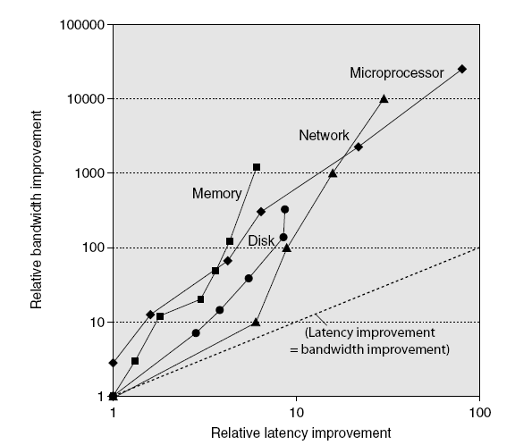
Bandwidth and Latency
Trends in Technology
Log-log plot of bandwidth and latency milestones

Slide 51
CPI Example
Computer A: Cycle Time = 250ps, CPI = 2.0
Computer B: Cycle Time = 500ps, CPI = 1.2
Same ISA
Which is faster, and by how much?
A is faster…
…by this much
35

Slide 52
Instruction Count and CPI
Instruction Count for a program
Determined by program, ISA and compiler
Average cycles per instruction
Determined by CPU hardware
If different instructions have different CPI
Average CPI affected by instruction mix
37

Slide 53
CPI in More Detail
If different instruction classes take different numbers of cycles
Weighted average CPI
Relative frequency
37

Slide 54
CPI Example
Alternative compiled code sequences using instructions in classes A, B, C
Class | A | B | C
CPI for class | 1 | 2 | 3
IC in sequence 1 | 2 | 1 | 2
IC in sequence 2 | 4 | 1 | 1
Sequence 1: IC = 5
Clock Cycles = 2×1 + 1×2 + 2×3 = 10
Avg. CPI = 10/5 = 2.0
Sequence 2: IC = 6
Clock Cycles = 4×1 + 1×2 + 1×3 = 9
Avg. CPI = 9/6 = 1.5
37

Slide 55
Performance Summary
The BIG Picture
Time is the most complete measure of performance
Performance depends on
Algorithm: affects IC, possibly CPI
Programming language: affects IC, CPI
Compiler: affects IC, CPI
Instruction set architecture: affects IC, CPI, T_{c}
38

Slide 56
Come and See My Etchings…
Complementary Metal Oxide Semiconductor
Used in almost all CPU and memory manufacturing today
Combination of positive doped and negative doped areas on the silicon
Manufacture involves successive steps of depositing/growing metal layers and etching them
P-type and N-type transistors are interleaved to facilitate connection and lower power drain

Slide 57
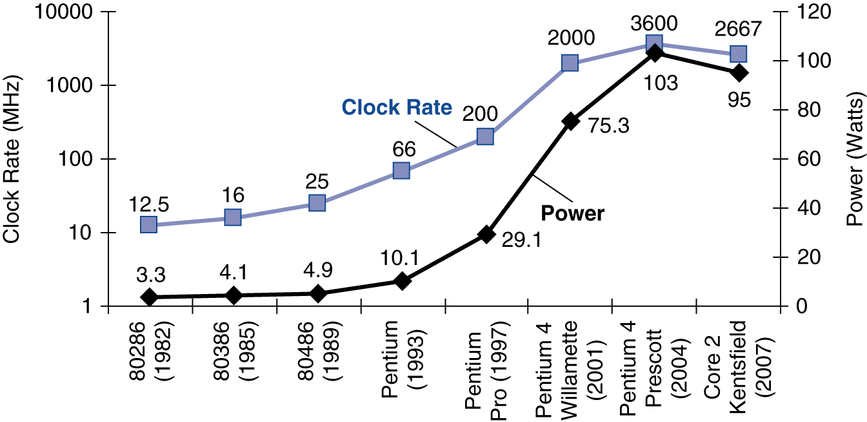
Power Trends
§1.5 The Power Wall
In CMOS IC technology
×30
5V → 1V
×1000
40

Slide 58
Reducing Power
Suppose a new CPU has
85% of capacitive load of old CPU
15% voltage and 15% frequency reduction
The power wall
We can’t reduce voltage further
We can’t remove more heat
How else can we improve performance?
41

Slide 59
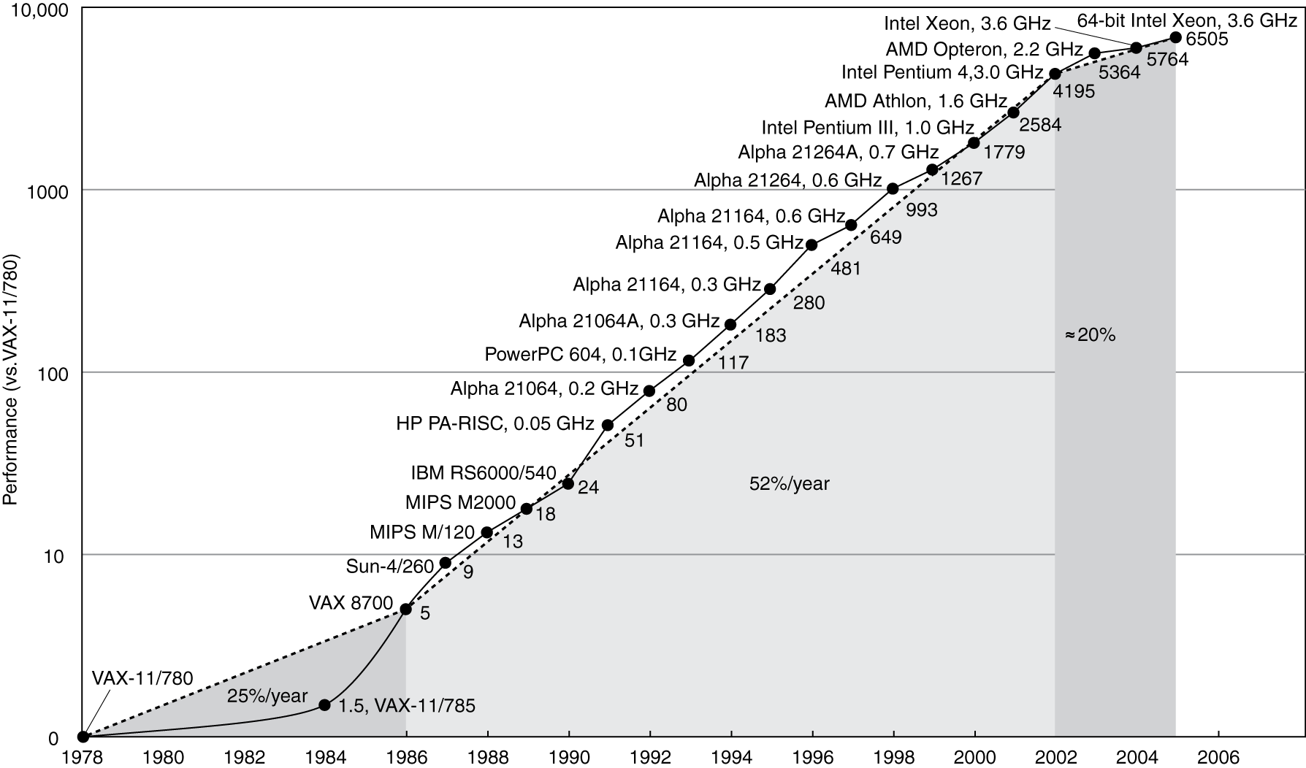
Uniprocessor Performance
§1.6 The Sea Change: The Switch to Multiprocessors
Constrained by power, instruction-level parallelism, memory latency
44

Slide 60
Multiprocessors
Multicore microprocessors
More than one processor per chip
Requires explicitly parallel programming
Compare with instruction level parallelism
Hardware executes multiple instructions at once
Hidden from the programmer
Hard to do
Programming for performance
Load balancing
Optimizing communication and synchronization

Slide 61
SPEC CPU Benchmark
Programs used to measure performance
Supposedly typical of actual workload
Standard Performance Evaluation Corp (SPEC)
Develops benchmarks for CPU, I/O, Web, …
SPEC CPU2006
Elapsed time to execute a selection of programs
Negligible I/O, so focuses on CPU performance
Normalize relative to a reference machine
Summarize as geometric mean of performance ratios
CINT2006 (integer) and CFP2006 (floating-point)
48

Slide 62
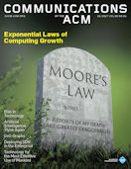
In the Current News
“Exponential growth depends on three levels of adoption in the computing ecosystem. The chip level is the domain of Moore's Law, as noted. However, the faster chips cannot realize their potential unless the host computer system supports the faster speeds and unless application workloads provide sufficient parallel computational work to keep the chips busy. And the faster systems cannot reach their potential without rapid adoption by the user community. The improvement process at all three levels must be exponential; otherwise, the system or community level would be a bottleneck, and we would not observe the effects often described as Moore's Law.”
(Communications of the ACM, January 2017, pp 54-65.)

Slide 63
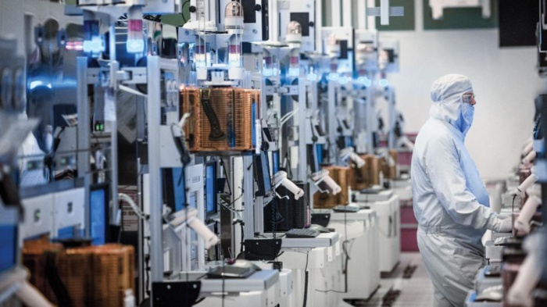
Intel pursues Moore's Law with plan to make 7-nm chips this year
Intel's next big Moore's Law advance will be a 7-nm pilot plant it is establishing this year to explore the upcoming manufacturing process. The chipmaker announced it was establishing the pilot plant during an earnings call on Thursday, January 26.

Slide 64
Amdahl’s Law
1922-2015
Exec time = time affected by improvement + time not affected by improvement
Assume parallelizable part is reduced proportional to the number of processors
Serial Process
Parallelizable Process
1
3
49

Slide 65
Serial Process
Parallelizable Process
1
3
With 3 processors:
Serial Process
Parallel Process
1
3/3 = 1
Process now takes 2 units to complete instead of 4
What if we had infinite processors?
49

Slide 66
General Formula
1
Speedup Factor =
Parallel fraction
Serial fraction +
Number of processors
1
=
=
1/0.5 = 2
0.25 + 0.75 / 3
49

Slide 67
Interesting Stuff
36-core, 1.2GHz chip
New IBM Machine
Longer Battery Life

